Slide 1
Automatic Ticketing System (ATS)
Group: SenseIT
Members: Rakesh, Karri, Klaudia, Nadin, Jose
Intelligent Buildings
Junction 2016

Slide 2


Opportunity
Running out of daily office supplies
Oblivious maintenance tasks
Human resource waste on tedious tasks
Floor inspection
Assign repetitive activities
Signing inspection papers

Slide 3
Solution
Ticketing System
Detect Problem – Failure or lack of supplies
Sensors.
Find suitable resource to fix problem
Location
Role
Generate and Assign ticket
Fix problem
Close ticket

Slide 4
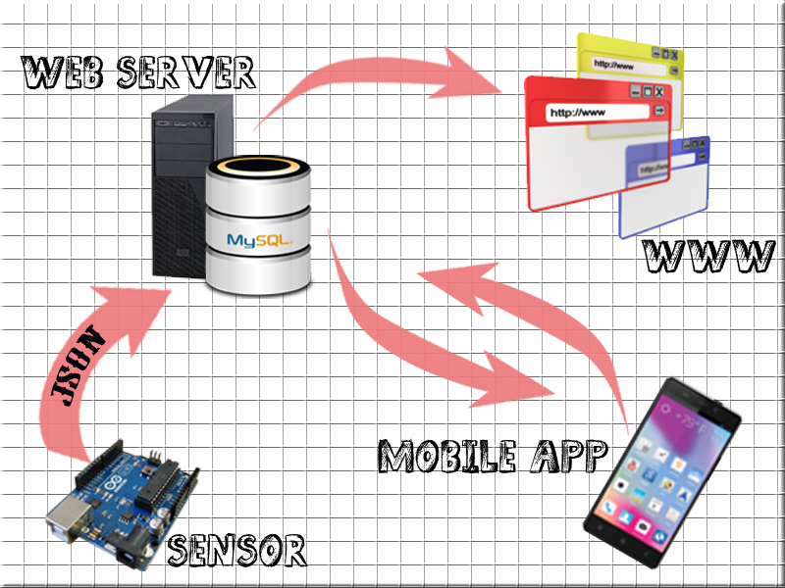
Solution Architecture

Slide 5
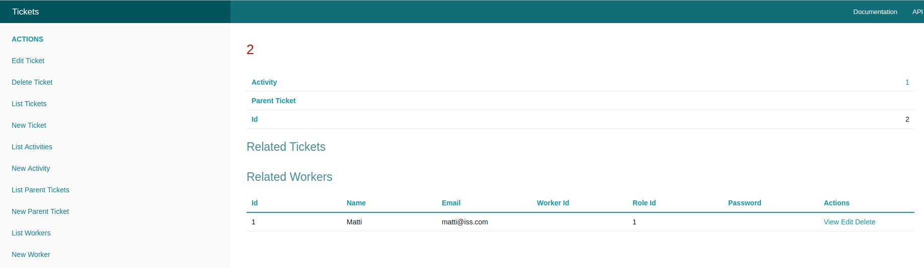
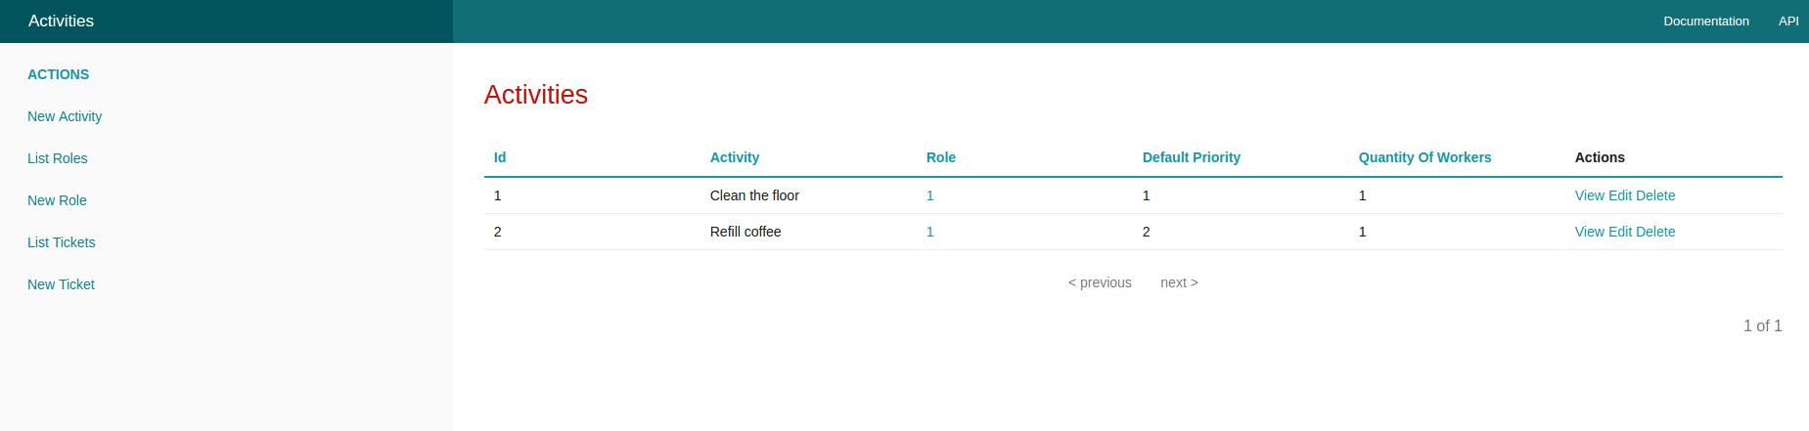
Frontend - Manager

Slide 6
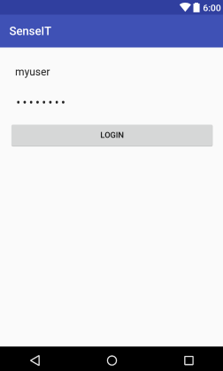
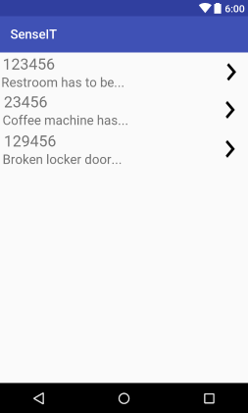
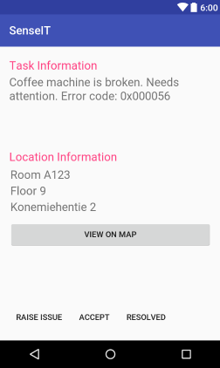
Frontend - Worker

Slide 7
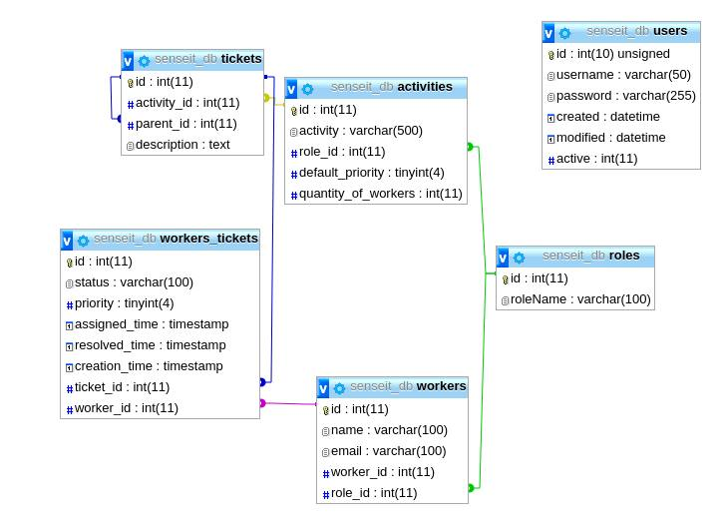
Backend

Slide 8
Bounty
Improve response time
Automated Maintenance Processes
Efficient Resource Utilization
Reducing costs on HR
Accountability

Slide 9
THANK YOU!

